Slide 1
Introduction
Carl Gruhn
Communication for Software Leaders
Assignment 3

Slide 2
Overview
Where I’m from
Educational Background
Accomplishments
Interests

Slide 3
Background
Baltimore, MD
Mechanical Engineering, B.S.
Toledo, OH
Computer Science, B.S.
Pittsburgh, PA
Software Engineering M.S.

Slide 4
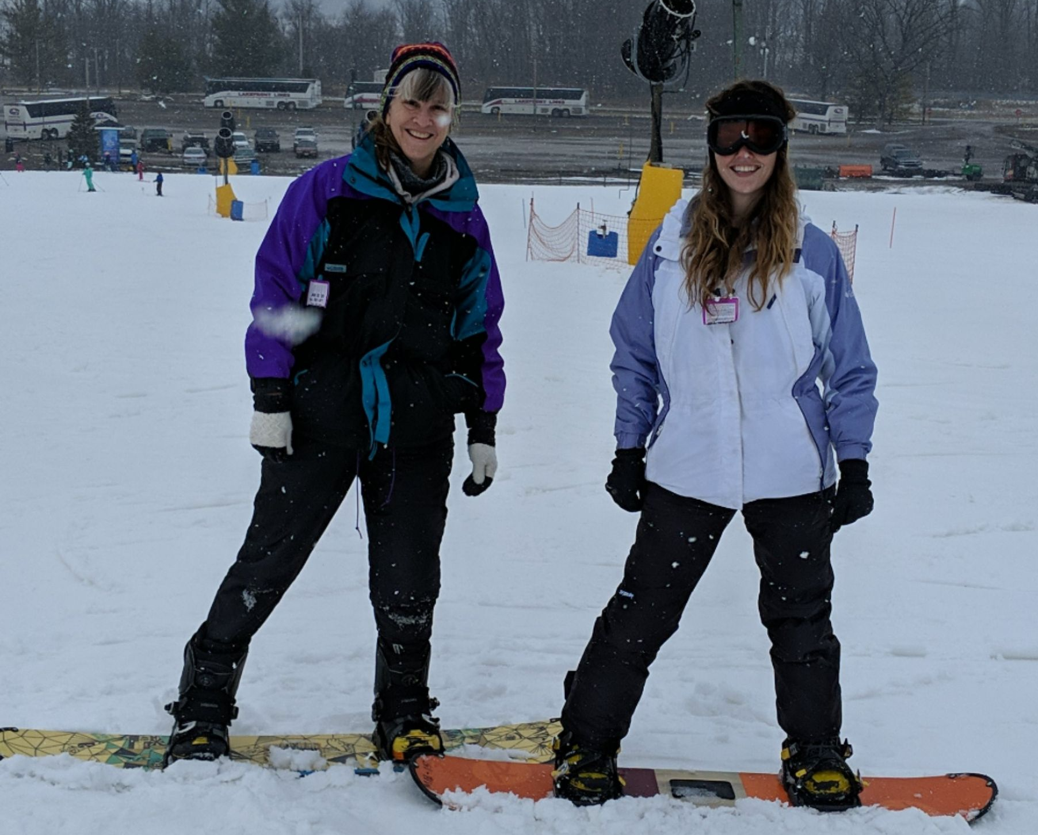
Additional Information
Accomplishments
Interests
Transitioned Careers
Workplace Nomination
Got sister into D&D
TTRPGs
Boardgames
Skiing / Snowboarding

Slide 5
Conclusion
Lived some places
Earned a few degrees
Accomplished things
Like some stuff

Slide 6
Questions?

